Slide 1
DSI Project
Combined Data Visualizations
John Koenig - 16JUN2021

Slide 2
Combined Data Visualizations
Box Plots
Correlation Heatmap
6 x Histogram Multi-plots
Confusion Matrix Heatmaps
Top 10 Models Table
Visualize Decision Tree
Multi-ROC Curve Plot

Slide 3
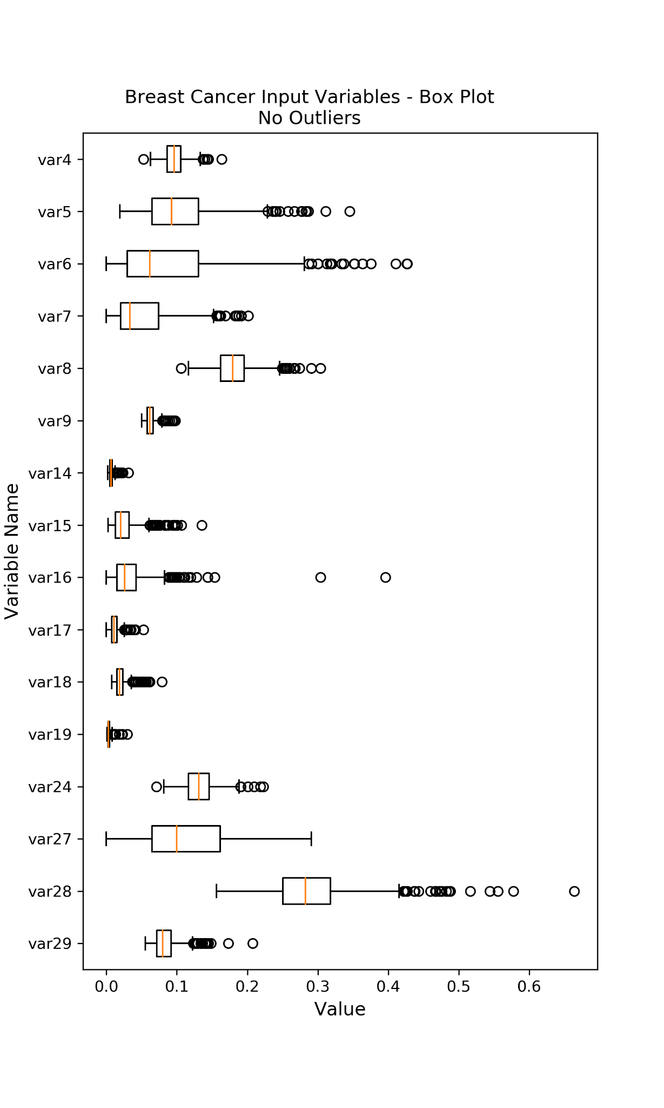
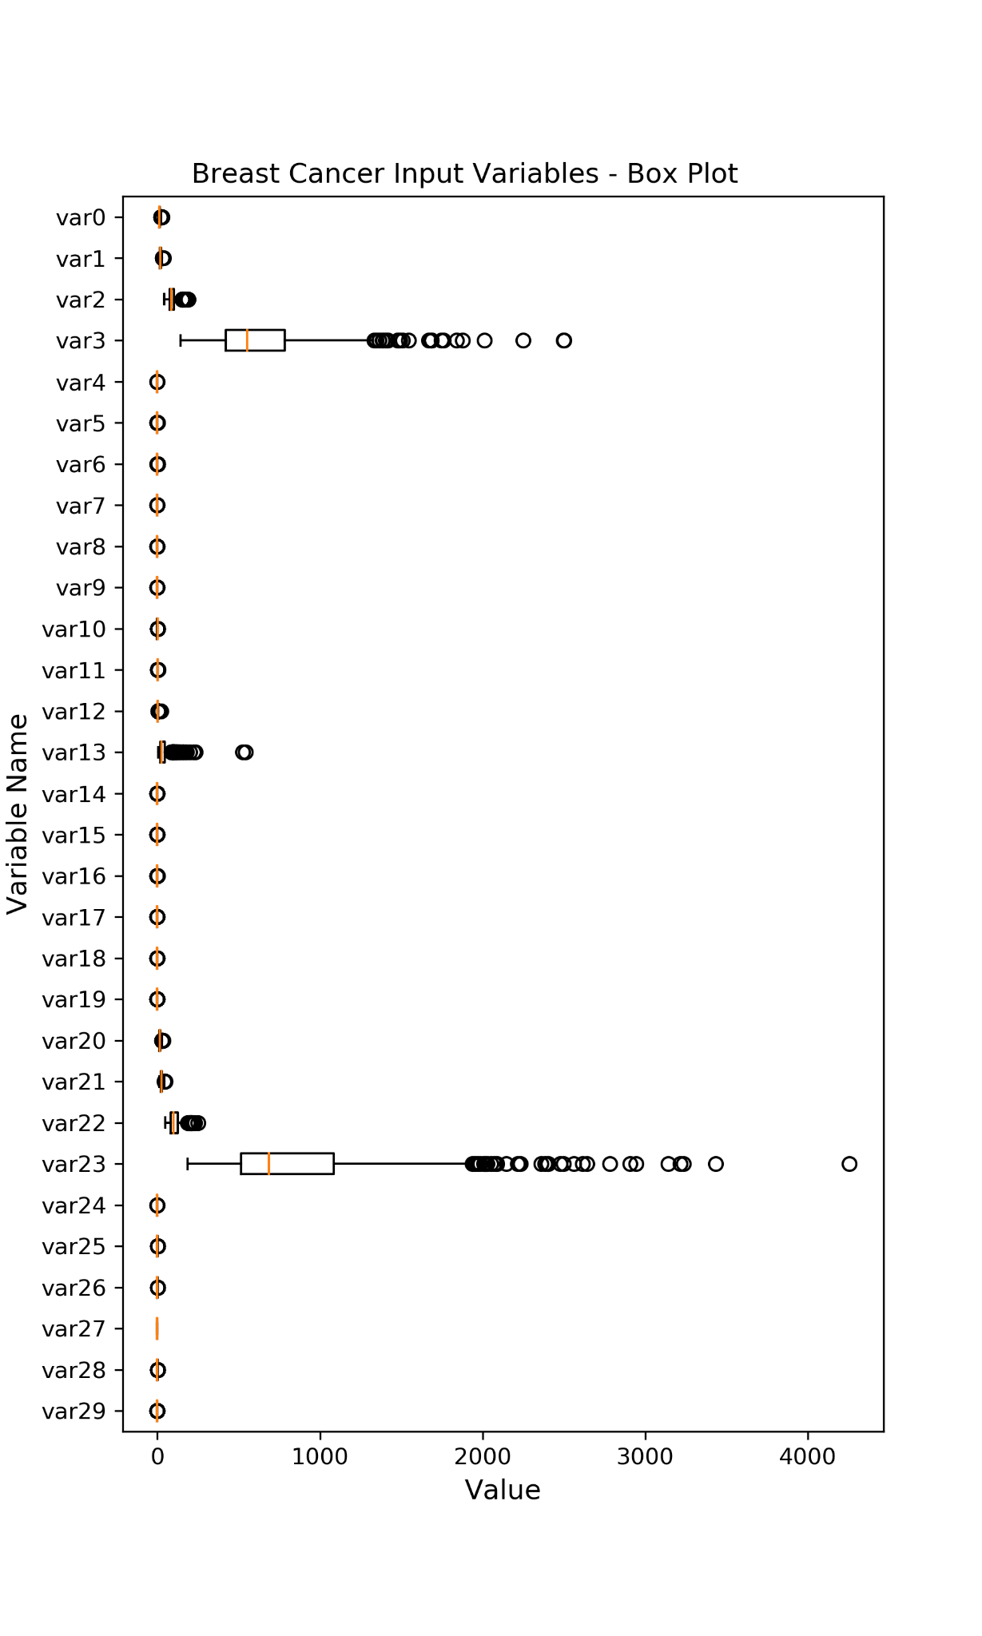

Slide 4
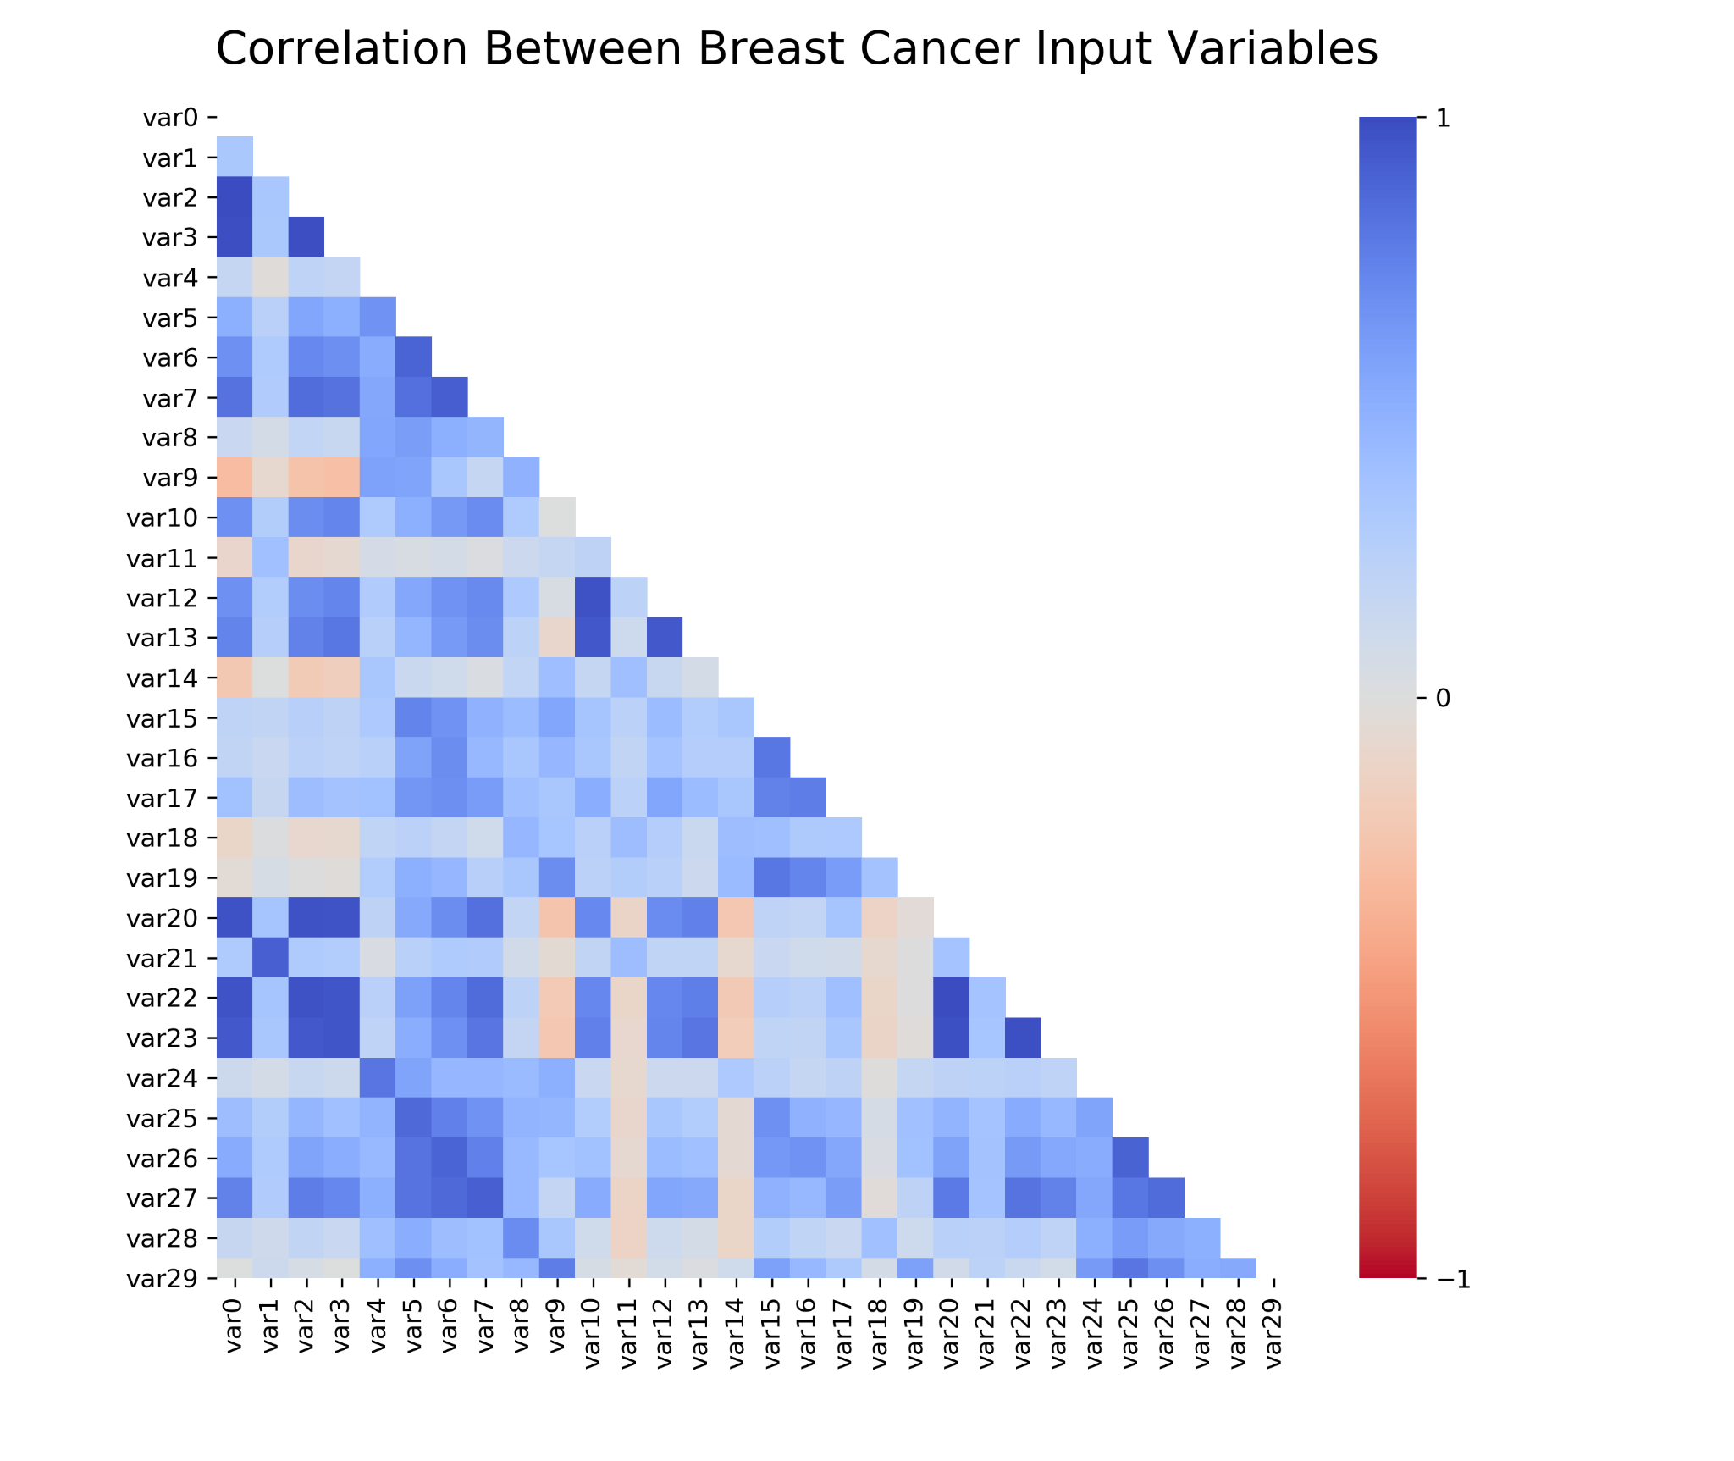

Slide 5
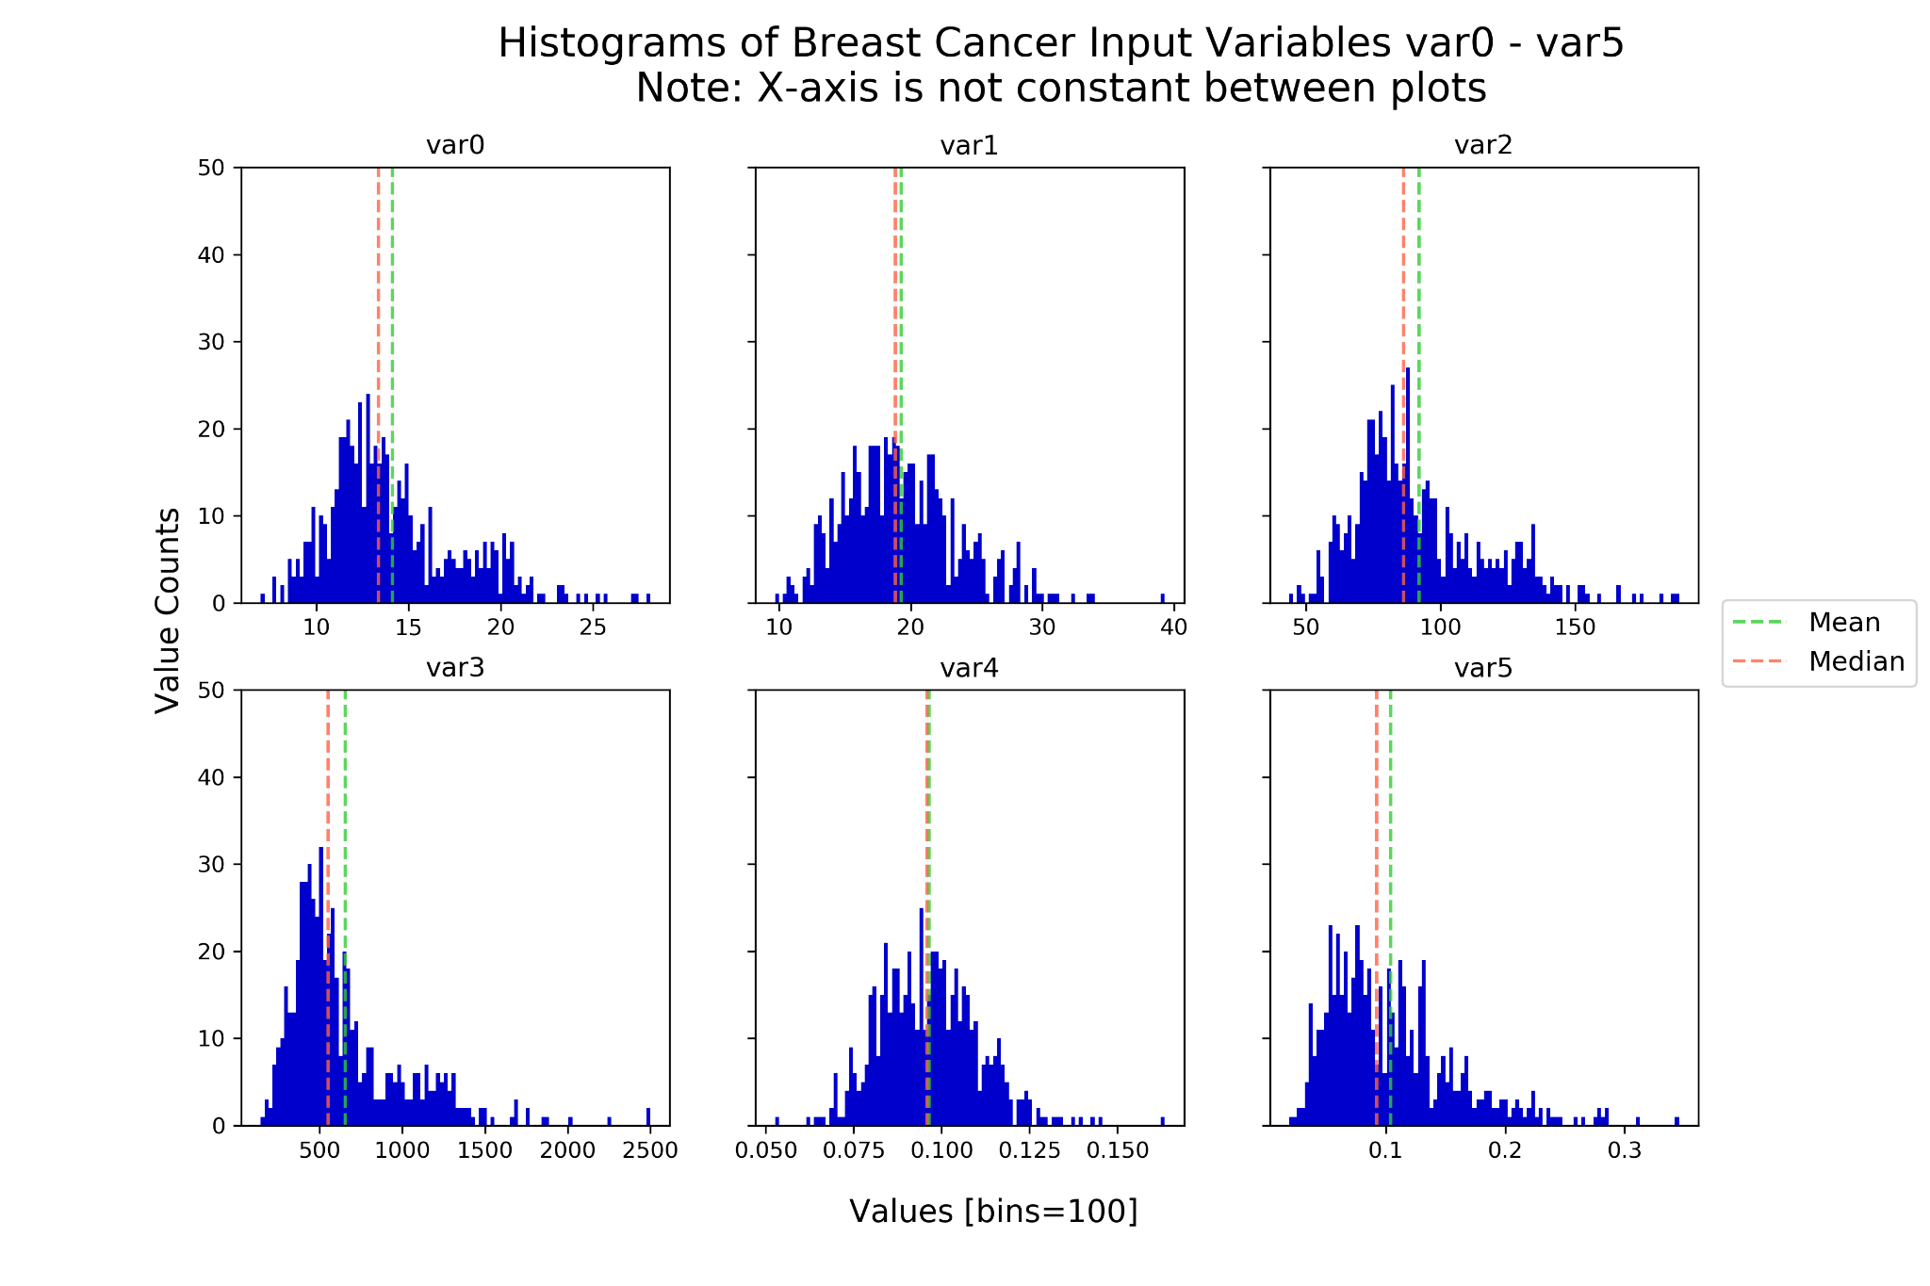

Slide 6
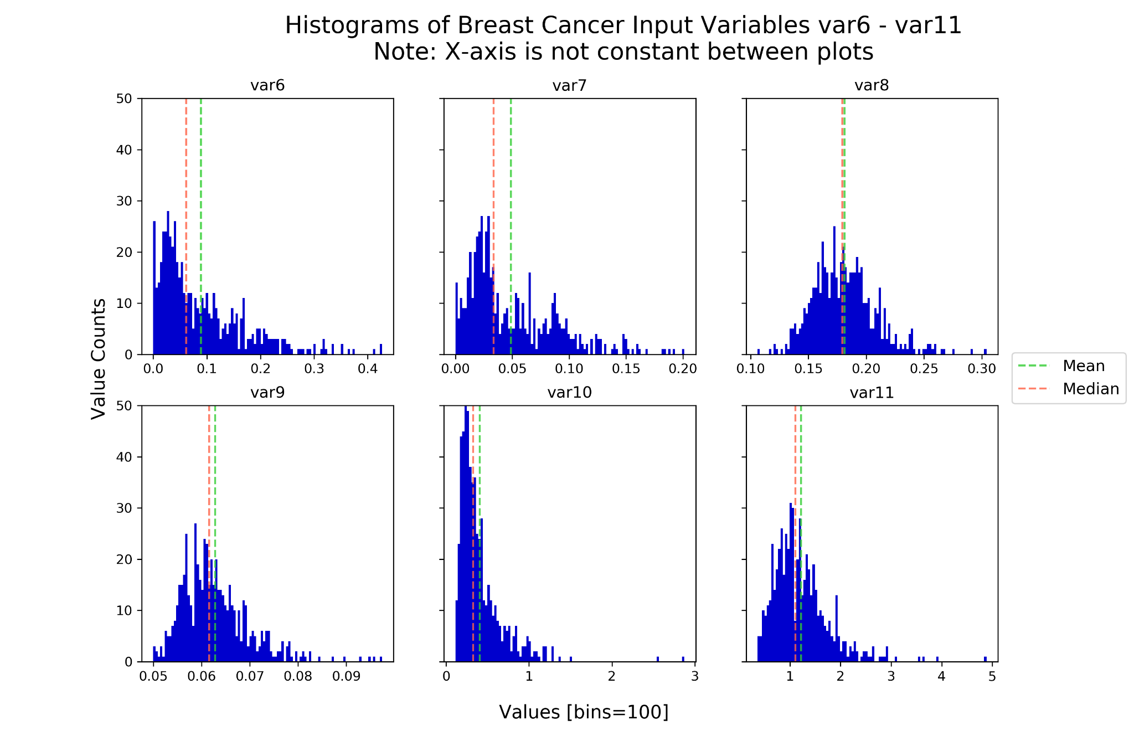

Slide 7
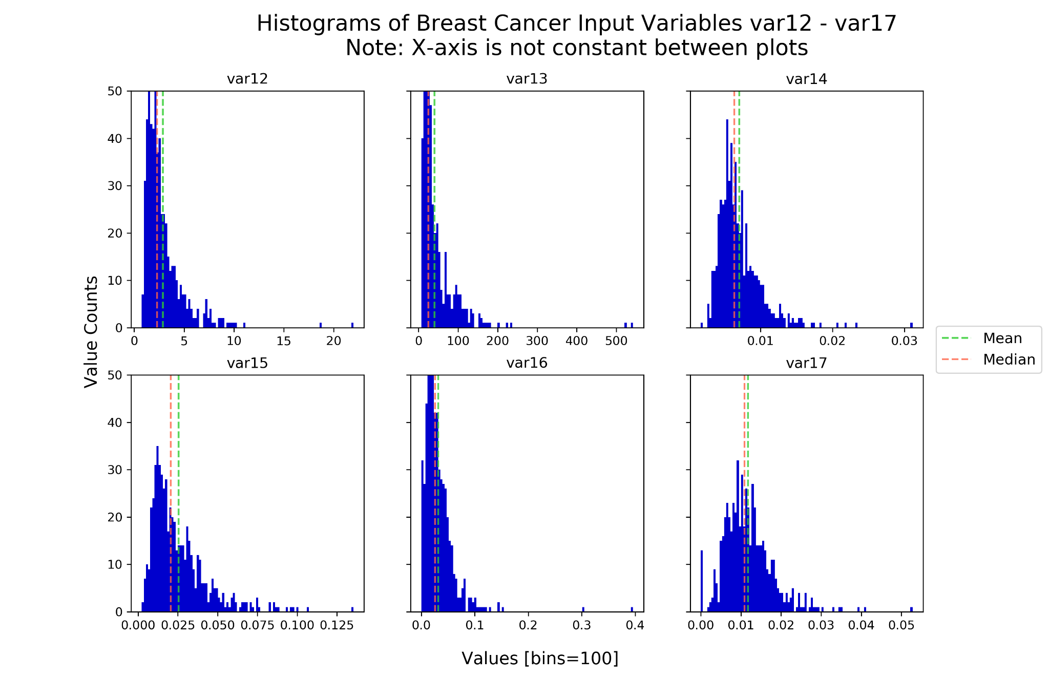

Slide 8
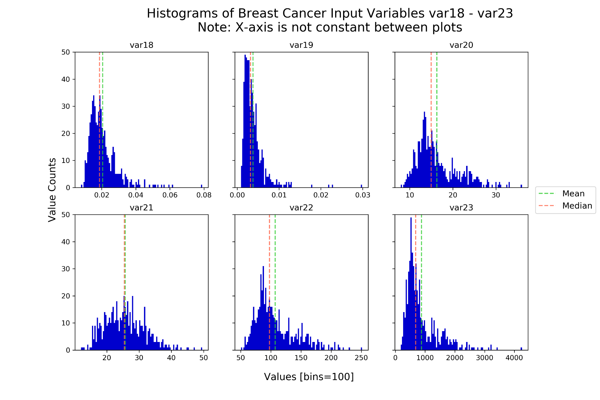

Slide 9
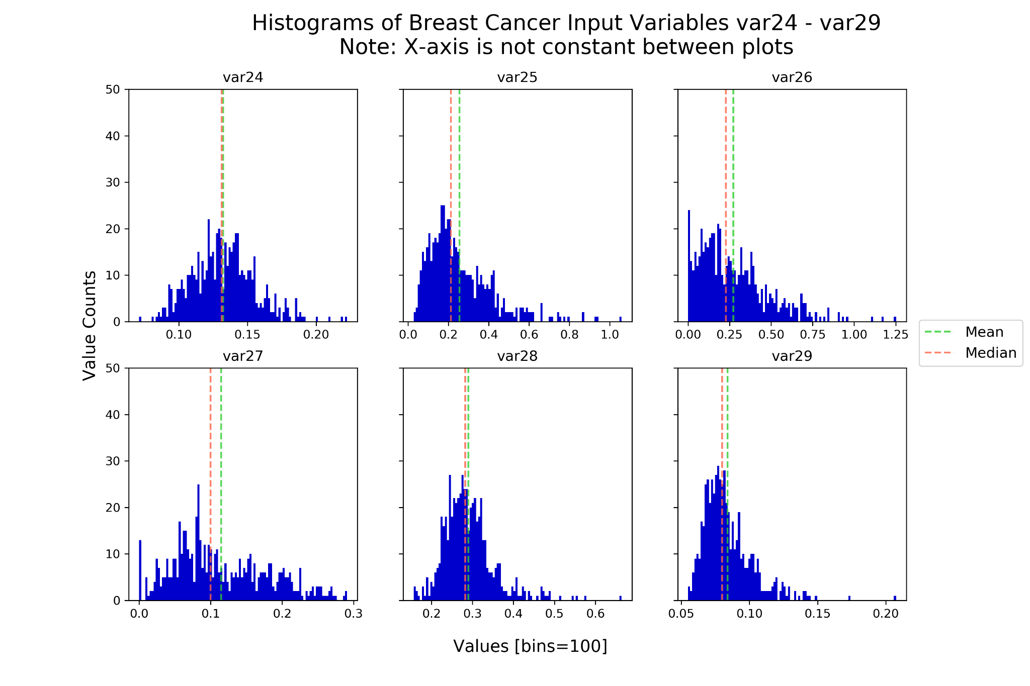

Slide 10
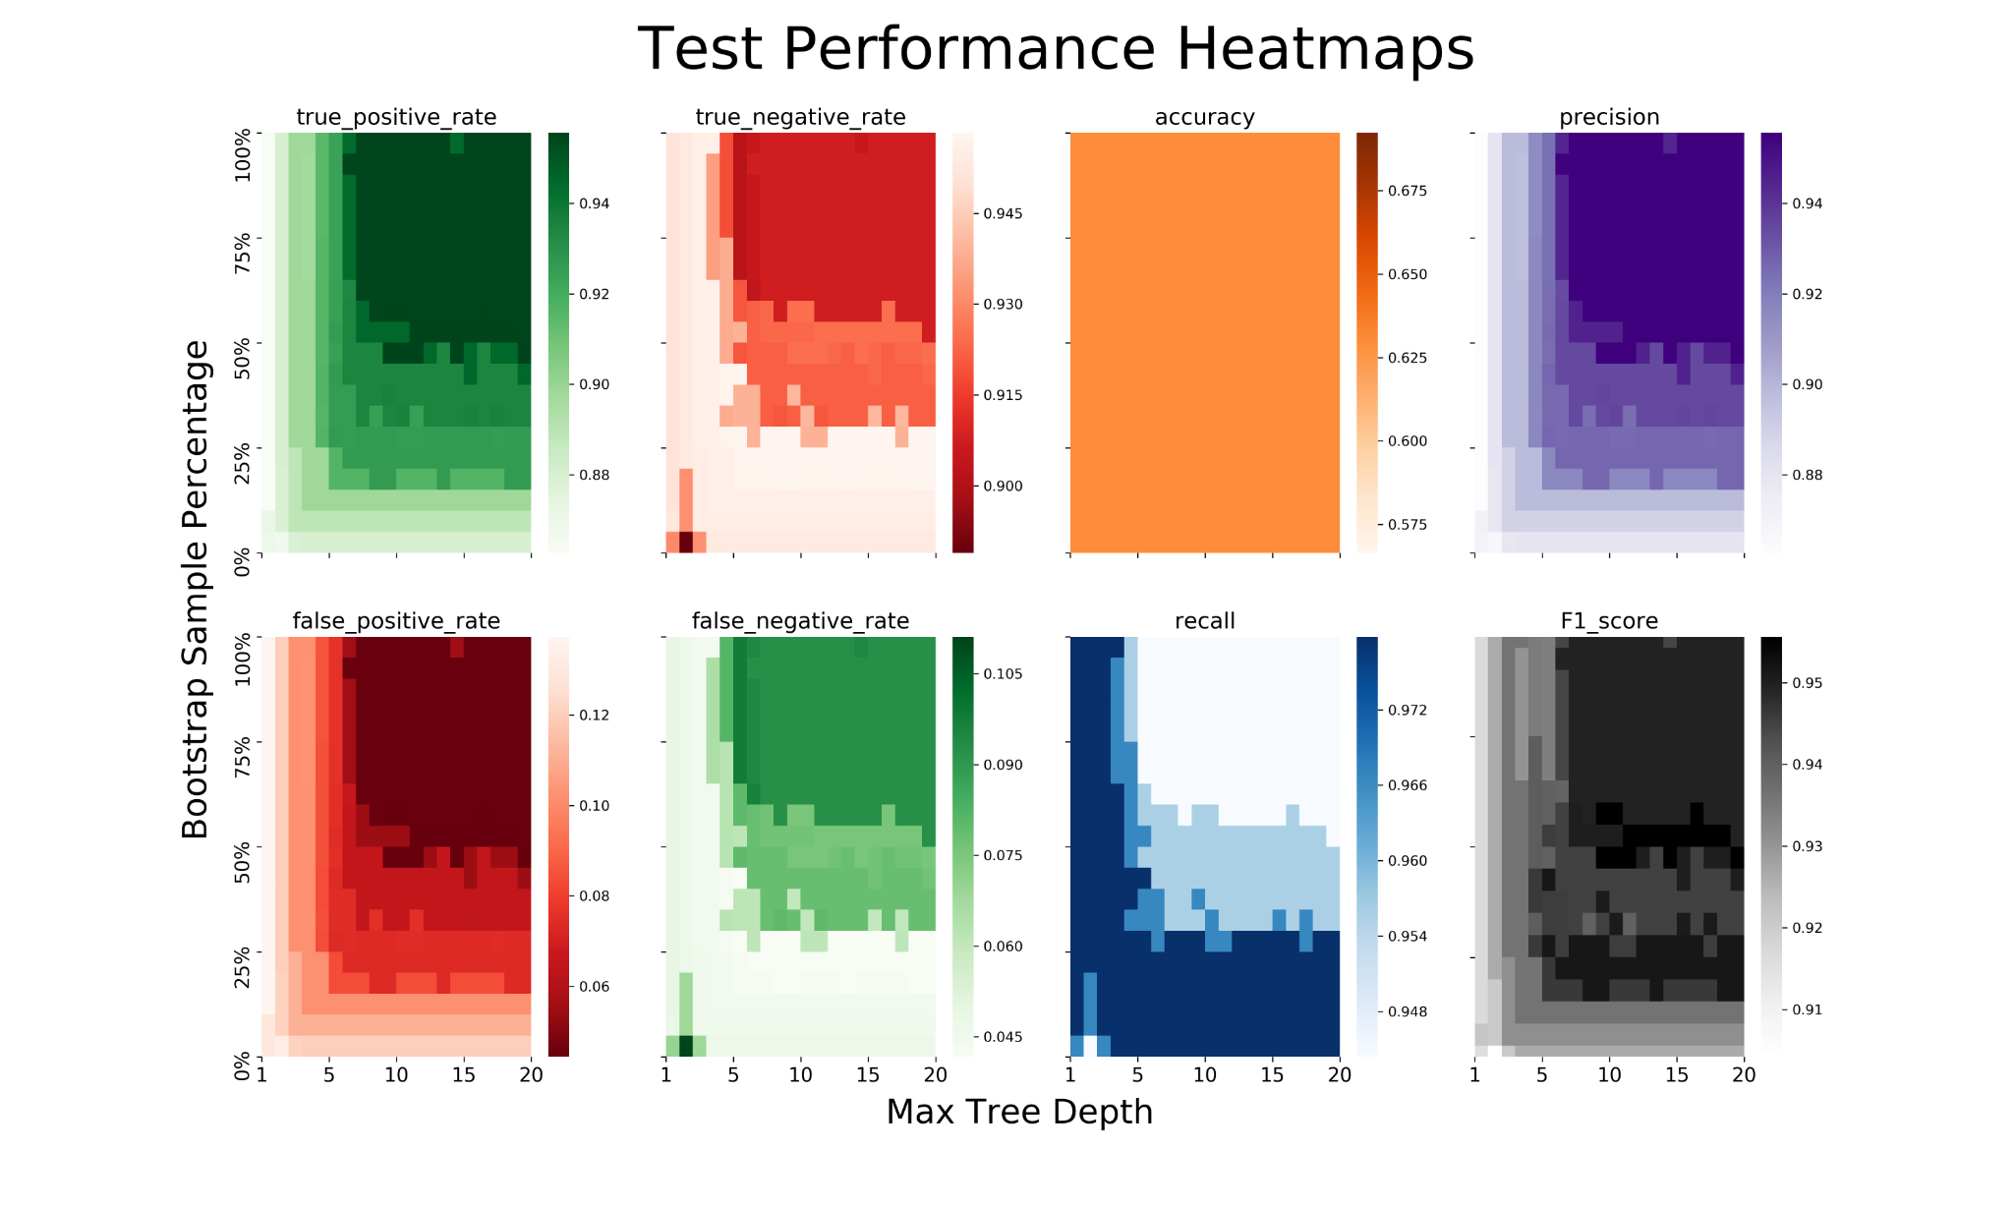

Slide 11
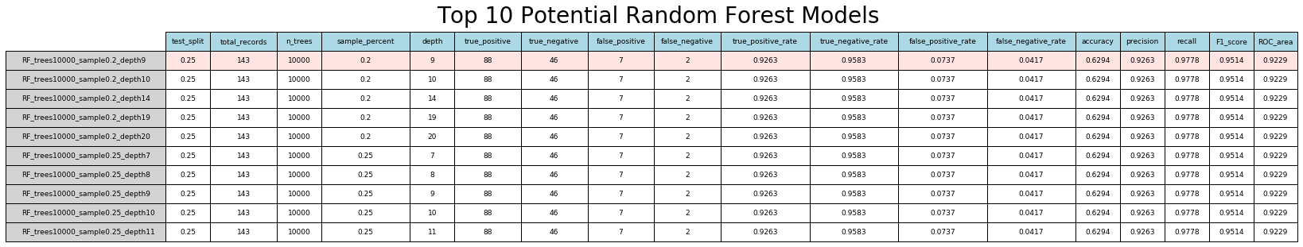

Slide 12
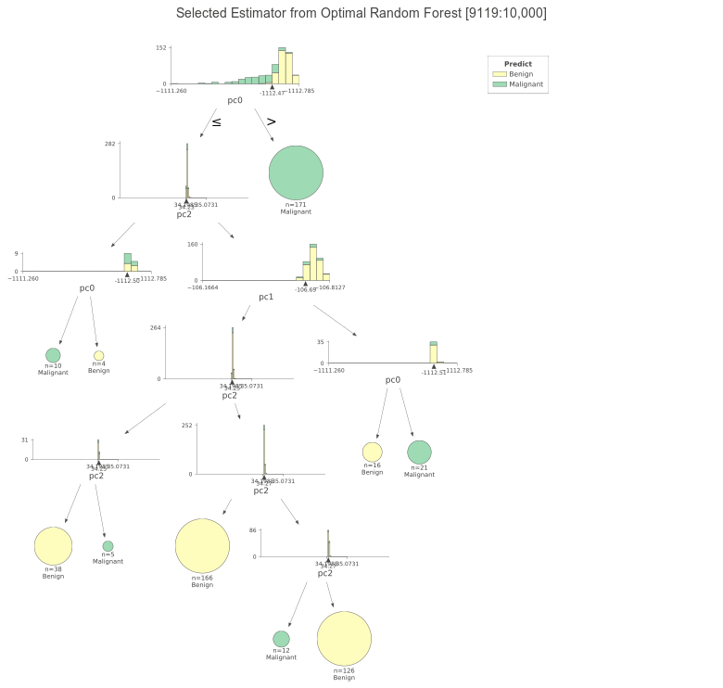

Slide 13
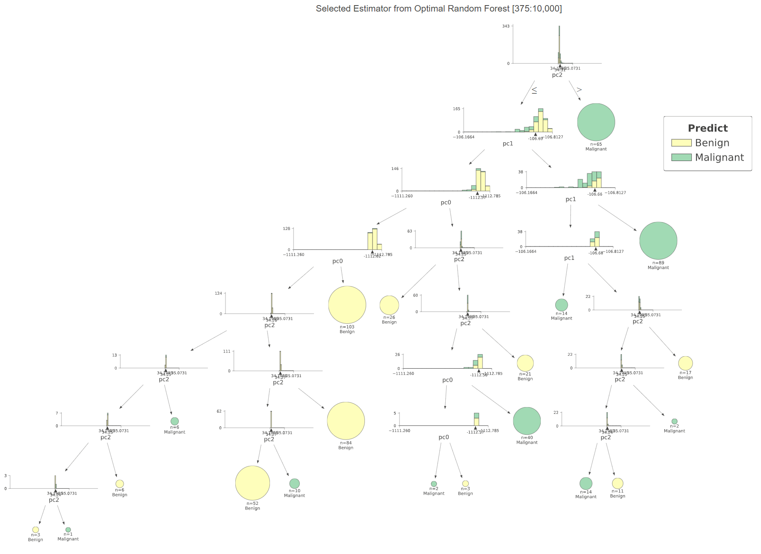

Slide 14
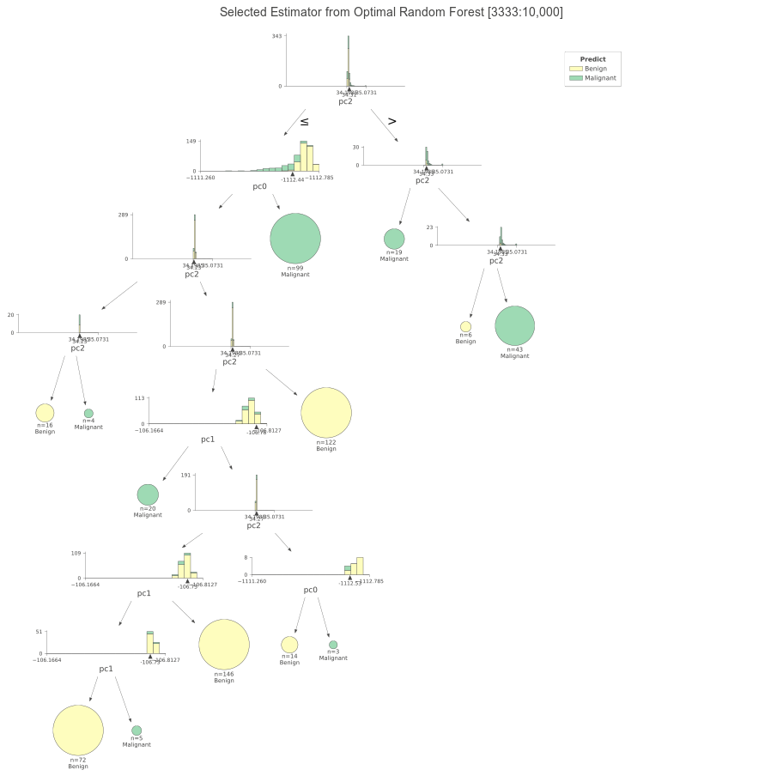

Slide 15
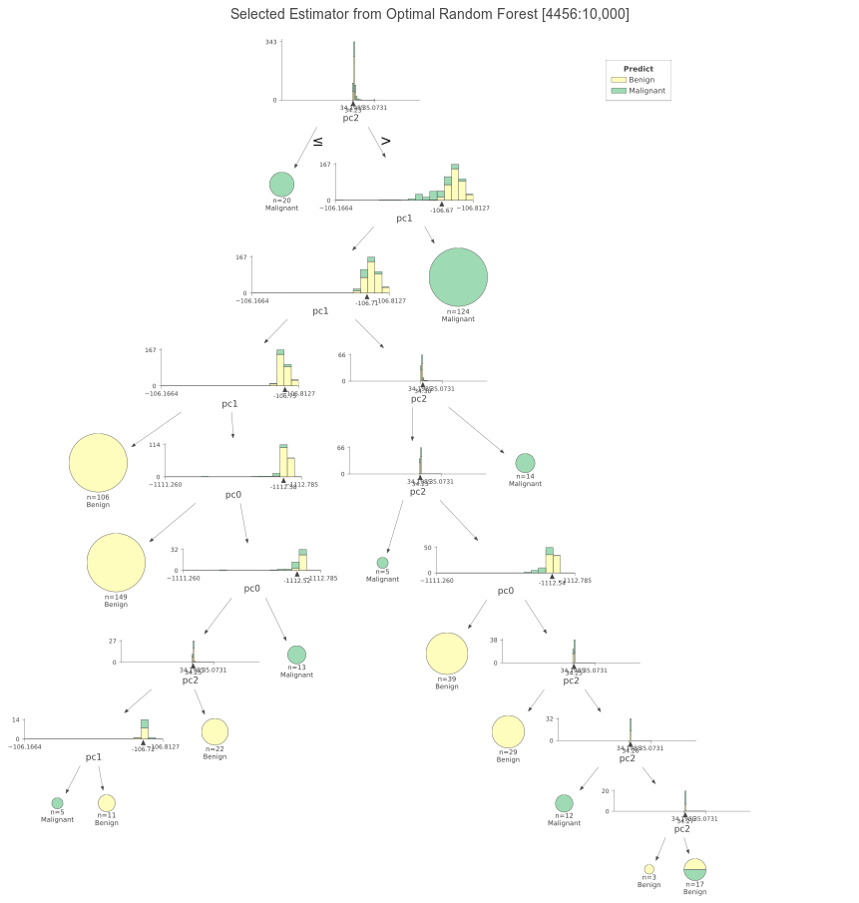

Slide 16
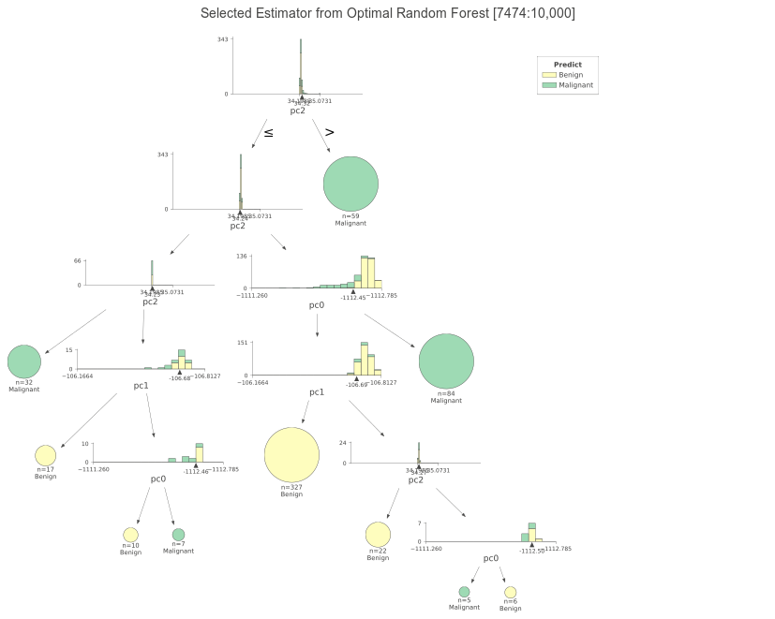

Slide 17
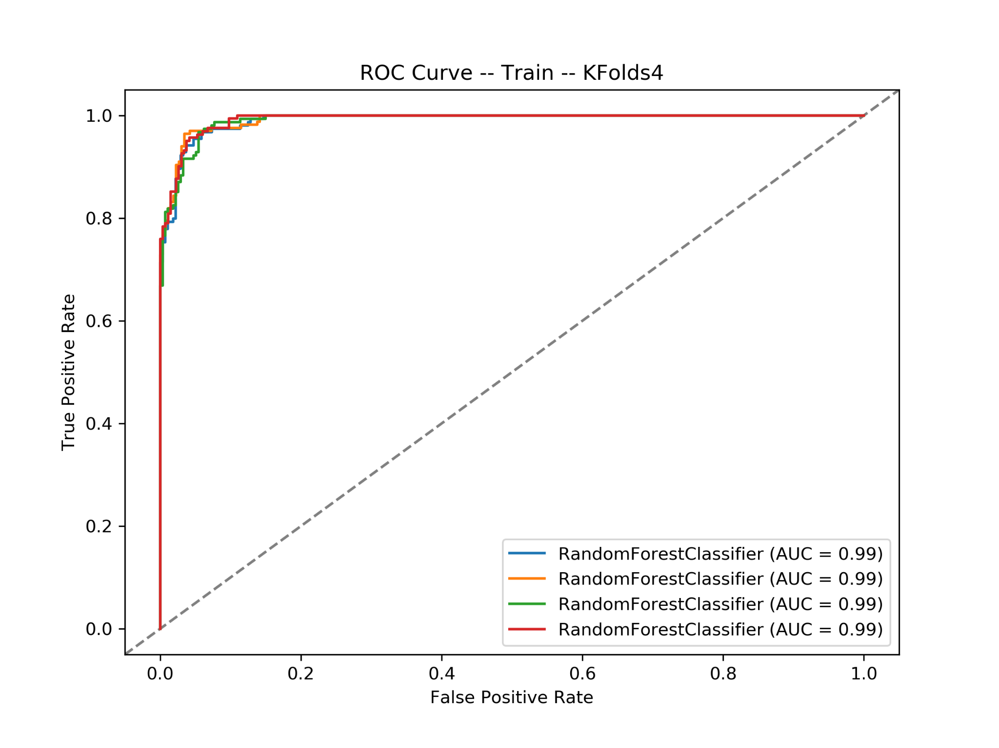

Slide 18
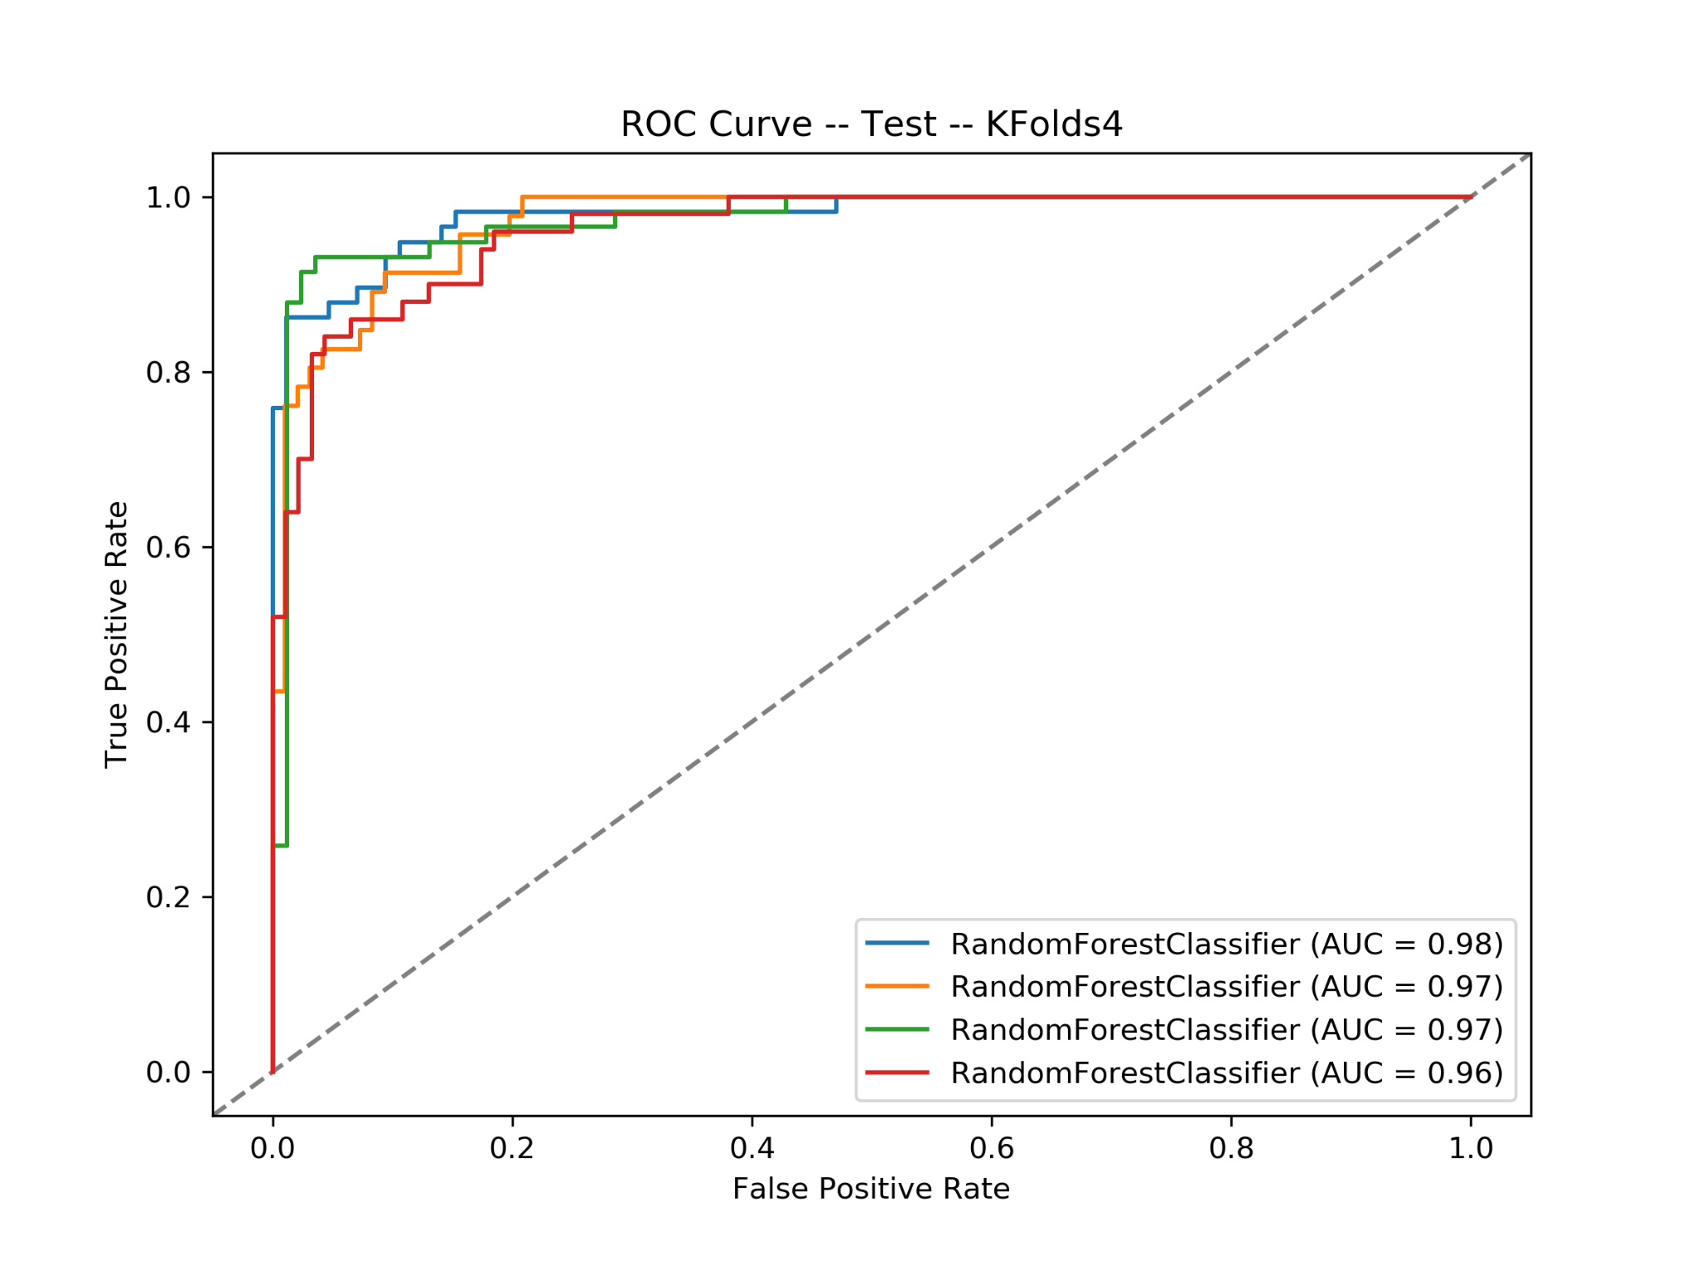

Slide 19


Contact
Thank you for reviewing my DSI project for General Assembly
If you have any comments or feedback about this course content, please contact:
John Koenig Faculty Affiliate, Regis University
Master of Data Science Program
jkoenig0002@regis.edu

